Slide 1




SECOND REVIEW
PROJECT 1 – BCE498J
TITLE - Advanced Fundus Analysis: Deep Learning for Retinopathy of Prematurity Diagnosis
PRESENTED BY
DIVYANSH RAWAL (21BLC1123)
AKARSHIT MISRA (21BAI1597)
KIRTI SOURAV PANIGRAHI (21BCE6038)
Guide : Dr. ILAVENDHAN A

Slide 2
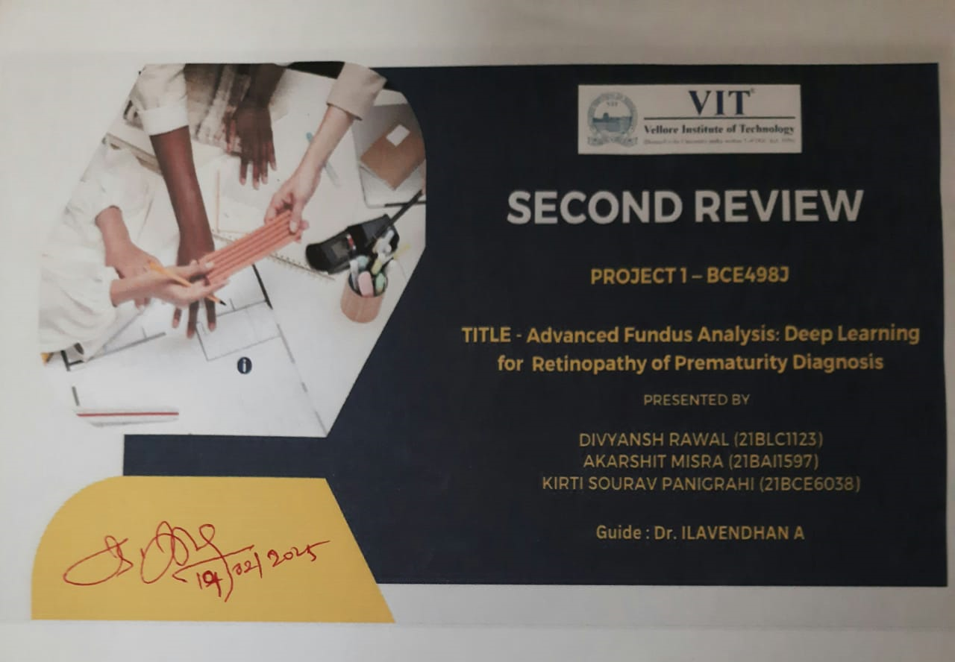


Slide 3
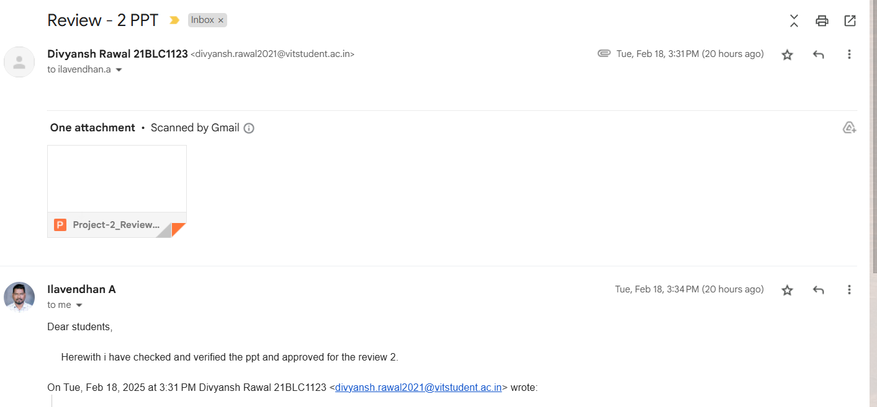

Slide 4
INTRODUCTION
Retinopathy of Prematurity (ROP) is a severe eye disorder affecting premature infants due to abnormal retinal blood vessel growth.
It is a leading cause of preventable childhood blindness, making early detection crucial for timely intervention.
Diagnosis relies on fundus imaging, where ophthalmologists analyze retinal images to identify signs of the disease.
Manual diagnosis is time-consuming, requires specialized expertise, and is subject to inter-observer variability.
A shortage of trained specialists in many regions limits timely diagnosis and treatment, increasing the risk of vision loss.
Deep learning has emerged as a powerful tool in medical imaging, offering automated and efficient diagnostic solutions.

Slide 5
INTRODUCTION
Object detection models like YOLO (You Only Look Once) enable real-time and accurate identification of abnormalities in medical images.
This project focuses on using YOLOv8 and YOLOv11 for the detection of ROP in fundus images and comparing their performance.
The comparison is based on key metrics such as mean average precision (mAP), inference speed, and computational efficiency.
The objective is to determine which model offers superior accuracy, speed, and feasibility for integration into real-world clinical applications.
Automated deep learning-based screening systems can assist ophthalmologists in making quicker and more accurate diagnoses, improving early detection and reducing the burden on healthcare professionals.

Slide 6
PROBLEM STATEMENT
Retinopathy of Prematurity (ROP) is a leading cause of preventable childhood blindness, and early diagnosis is critical for effective treatment and preventing long-term vision loss.
The current manual diagnosis of ROP through fundus image analysis is time-consuming, subjective, and can vary between ophthalmologists, leading to inconsistent results.
A shortage of trained specialists in many regions delays timely diagnoses, increasing the risk of severe vision impairment in premature infants.
Existing automated methods for ROP detection struggle with real-time efficiency and accuracy, limiting their usefulness in clinical settings.
This study aims to compare YOLOv8 and YOLOv11 for automated ROP detection, evaluating performance in terms of accuracy, inference speed, and computational efficiency to determine the most effective model for real-time clinical applications, enabling faster, more reliable screening and early intervention.

Slide 7
RESEARCH OBJECTIVES
To compare the performance of YOLOv8 and YOLOv11 in detecting Retinopathy of Prematurity (ROP) in fundus images.
To evaluate the accuracy of both models in detecting retinal abnormalities associated with ROP.
To assess the inference speed of both YOLOv8 and YOLOv11, determining which model provides faster results suitable for real-time clinical use.
To analyze the computational efficiency of both models in terms of memory usage, processing power, and suitability for deployment on standard clinical hardware.
To determine the most effective model for automated ROP detection, ensuring it meets the requirements for early, reliable, and scalable screening in clinical settings.

Slide 8
PROPOSED SYSTEM
The proposed system automates the classification of Retinopathy of Prematurity (ROP) using various deep learning approaches
Here we are trying to maximize the accuracy of the model, we have currently tested It on models like You Only Look Once (YOLO) Model.
This system aims to assist medical professionals by providing reliable, early-stage diagnosis based on retinal fundus images.The system will involve various classification techniques
The proposed system will:
1) Reduce dependency on manual diagnosis and expertise.
2) Provide consistent, accurate, and timely ROP stage classification.

Slide 9
PROPOSED SYSTEM
The system automates Retinopathy of Prematurity (ROP) classification using deep learning models like and YOLO, aiming to improve detection accuracy and efficiency in analyzing fundus images.
It provides a reliable, early-stage diagnosis, reducing the dependency on manual diagnosis and expertise while ensuring consistent and timely classification of ROP stages.
By overcoming the time-consuming, subjective nature of traditional ROP diagnosis, the system ensures objective, accurate results with reduced human error.
The system is scalable and efficient, offering real-time screening that enhances early diagnosis and improves treatment outcomes while easing the burden on healthcare professionals.

Slide 10
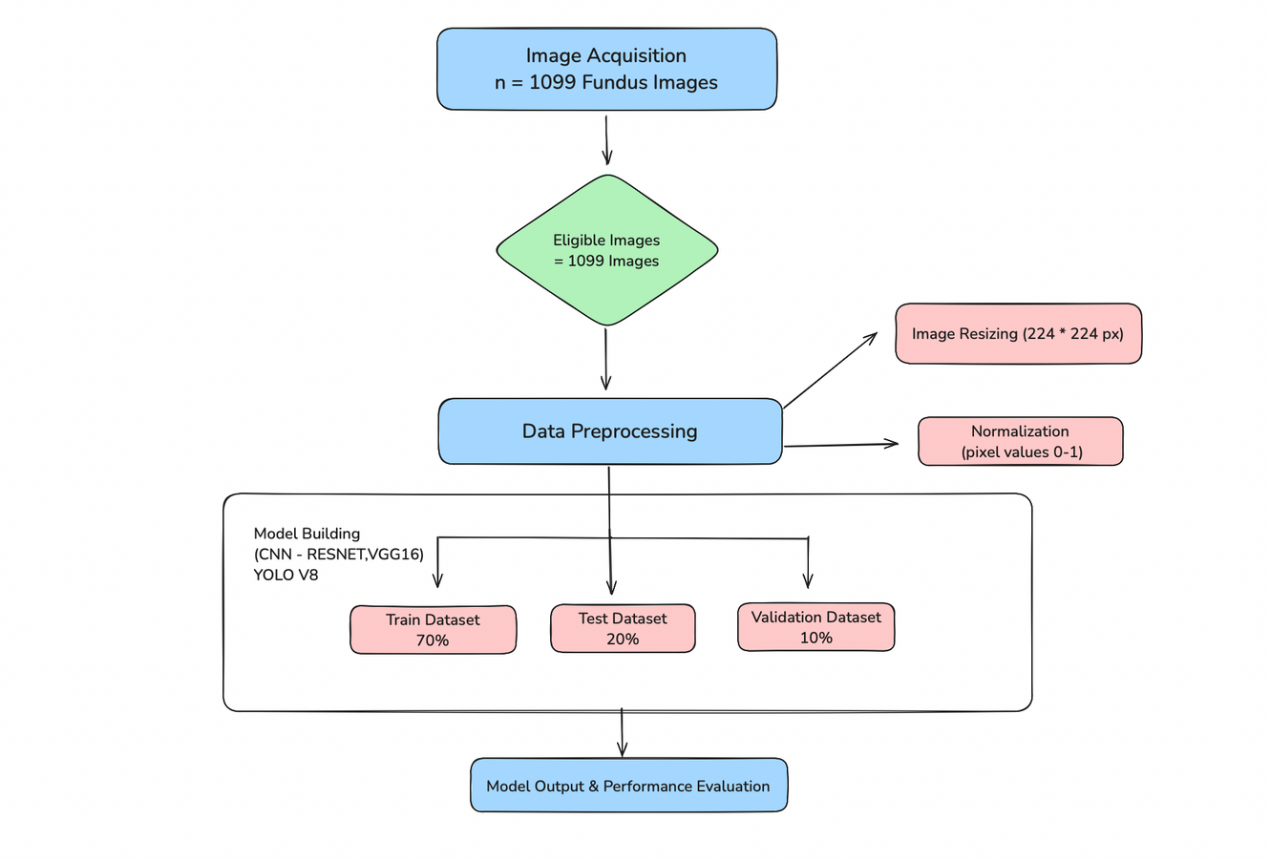
PROPOSED SYSTEM DIAGRAM

Slide 11
LIST OF MODULES
Here’s the list of modules for your ROP classification system:
Image Acquisition Module
Preprocessing Module
Feature Extraction Module
Model Training and Evaluation Module
ROP Classification Module
Post-Processing and Decision Module
Real-time Inference Module
Reporting and Feedback Module
Numpy Module
Seaborn Module

Slide 12
DESCRIPTION
Here’s a list of potential modules and the algorithms they could involve for your Retinopathy of Prematurity (ROP) classification system:
Image Acquisition Module:
Algorithm: Image capture through specialized fundus cameras or publicly available datasets.
Purpose: Acquire retinal fundus images for further analysis.
2. Preprocessing Module:
Algorithm:
Resizing and Normalization: Adjust image size and normalize pixel values.
Data Augmentation: Techniques like rotation, flipping, and scaling to enhance training data.
Image Enhancement: Contrast adjustment, histogram equalization for better visibility of features.
Purpose: Prepare images for deep learning models by improving image quality and augmenting data.

Slide 13
DESCRIPTION
3. Feature Extraction Module:
Algorithm:
Convolutional Neural Networks (CNNs): Automatically learn and extract relevant features from fundus images.
YOLOv8 and YOLOv11: Detect objects in the image (e.g., retinal abnormalities, blood vessels) using region proposal networks.
Purpose: Extract key features such as retinal abnormalities that indicate ROP.
4. Model Training and Evaluation Module:
Algorithm:
YOLOv8 and YOLOv11: Use these models for object detection and classification, training on a labeled dataset of fundus images.
Loss Functions: Cross-entropy loss, mean squared error for training deep learning models.
Optimization Algorithms: Adam, SGD (Stochastic Gradient Descent) for optimizing the models.
Purpose: Train and evaluate the deep learning models to detect ROP accurately.

Slide 14
DESCRIPTION
5. ROP Classification Module:
Algorithm:
YOLO-based Detection: Classify the stage of ROP based on detected abnormalities in fundus images.
Softmax or Sigmoid Function: For multi-class classification (ROP stages).
Purpose: Automatically classify images into ROP stages based on the features detected.
6. Post-Processing and Decision Module:
Algorithm:
Thresholding: Based on model output probabilities, thresholds are set to classify the ROP stage.
Non-maximum Suppression (NMS): Removes duplicate bounding boxes from the detection output.
Purpose: Final refinement of the classification results, improving accuracy by filtering out irrelevant or duplicate detections.

Slide 15
DESCRIPTION
7. Real-time Inference Module:
Algorithm:
YOLOv8 and YOLOv11 Inference: Fast inference for real-time classification on new fundus images.
Edge Computing and Model Optimization: Use of techniques like quantization or pruning to optimize models for deployment on low-resource devices.
Purpose: Provide real-time screening and classification for ROP in clinical settings.
8. Reporting and Feedback Module:
Algorithm:
Result Analysis: Generate a detailed report of the ROP stage and potential diagnosis.
Confidence Scores: Display confidence scores alongside classification results to guide medical decisions.
Purpose: Present the results to the healthcare professionals with easy-to-interpret outputs.

Slide 16
DESCRIPTION
7. Numpy Module:
Algorithm:
numpy (Numerical Python) is a powerful library for numerical computations.
Used for arrays, mathematical operations, and data manipulation.
8. Seaborn Module:
Algorithm:
Seaborn is built on Matplotlib and is used for statistical data visualization.
Provides prettier and more informative plots.

Slide 17
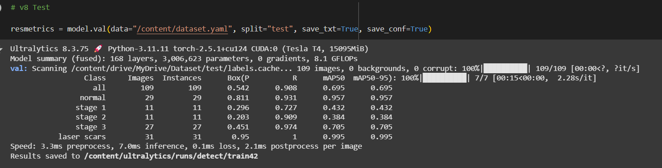
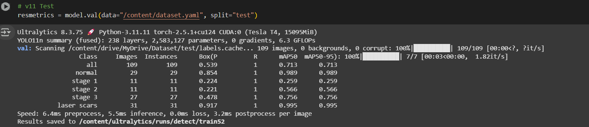
IMPLEMENTATION
RESULTS -

Slide 18
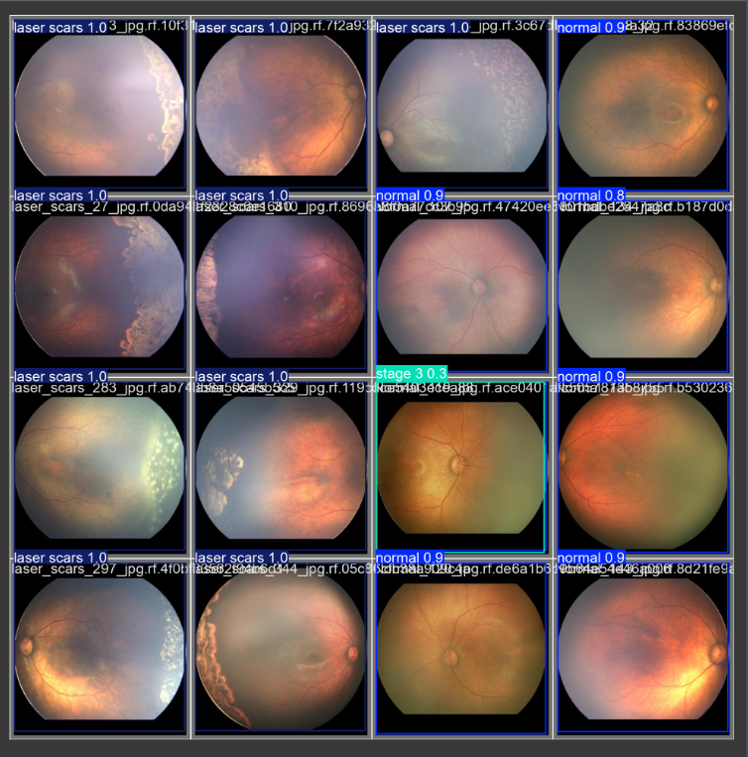
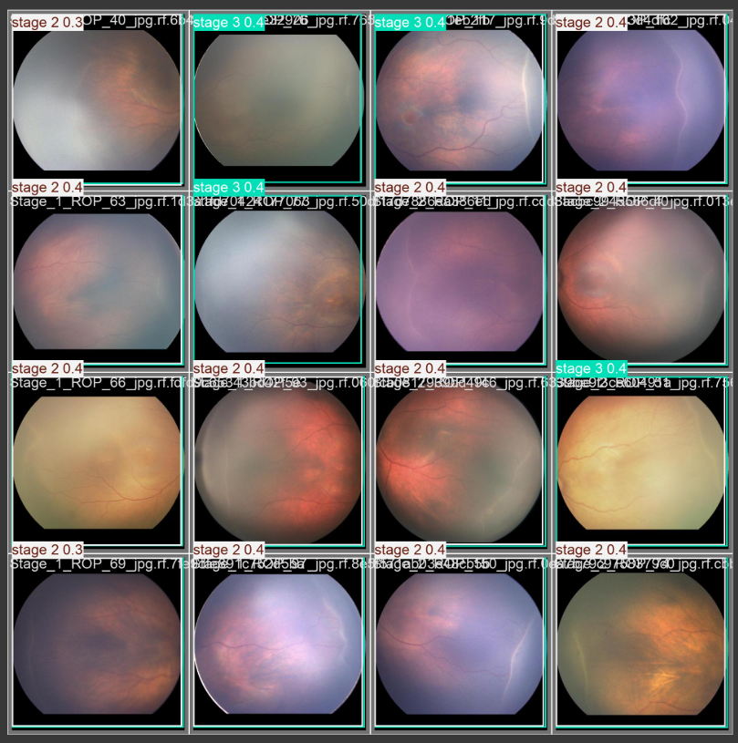
IMPLEMENTATION
RESULTS -

Slide 19
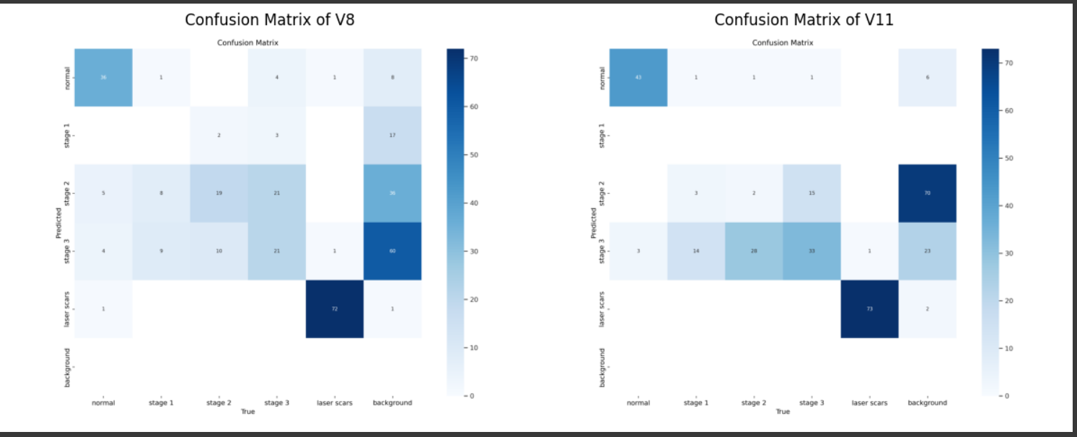
IMPLEMENTATION
RESULTS -

Slide 20
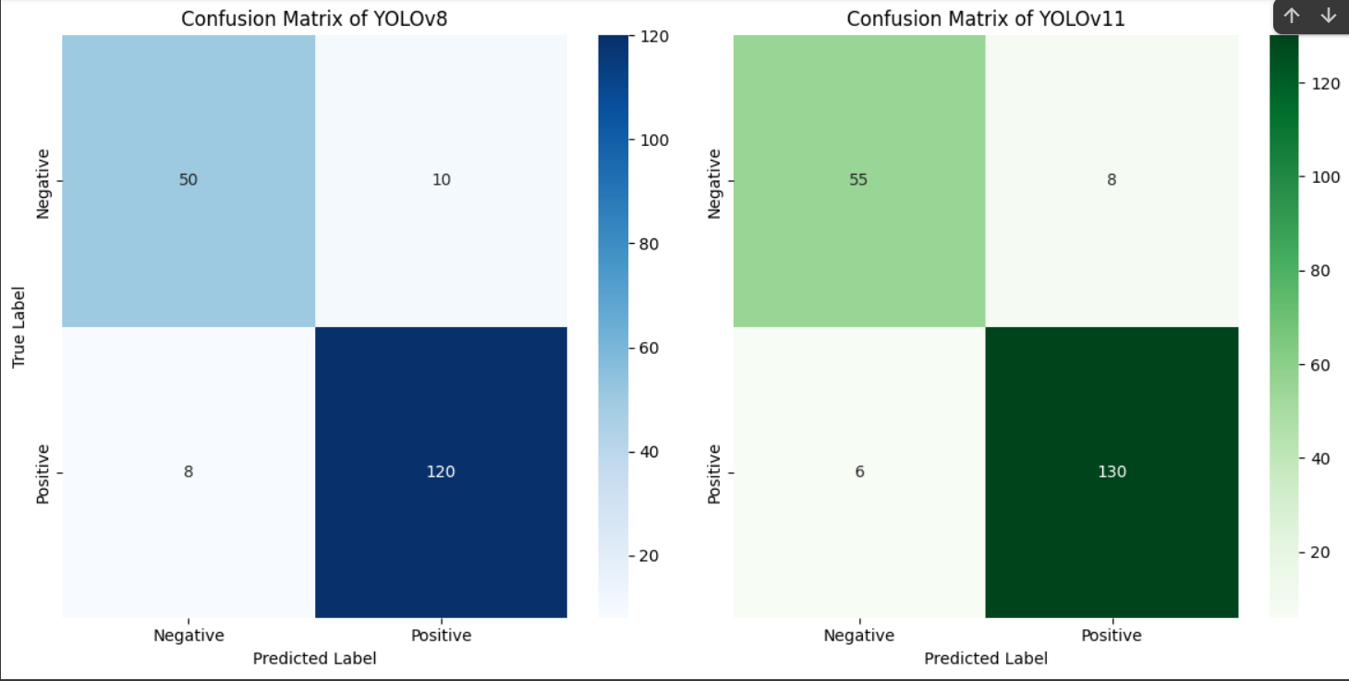
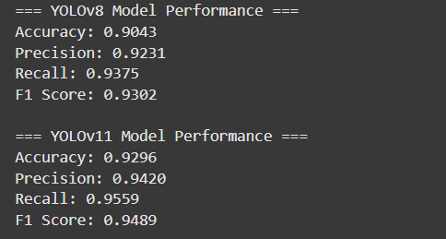
IMPLEMENTATION
RESULTS -

Slide 21
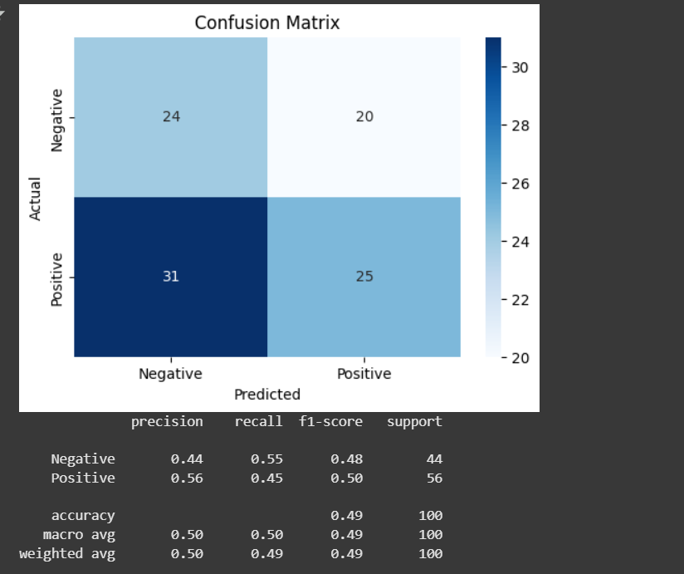
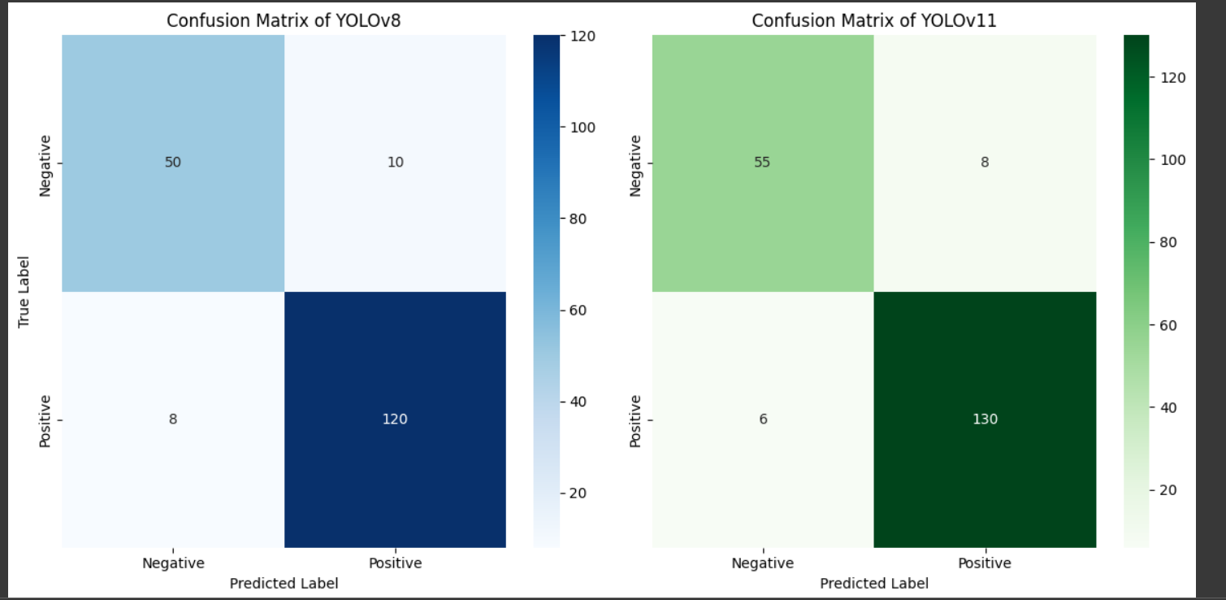
IMPLEMENTATION

Slide 22
IMPLEMENTATION
RESULTS AND FINDINGS -
Accuracy (Mean Average Precision - mAP)
1). YOLOv8 achieved an mAP of 69.5%, while YOLOv11 attained an mAP of 71.3%.
2). The higher accuracy of YOLOv11 suggests improved object detection capabilities, potentially due to enhanced feature extraction and model architecture.
Computational Efficiency
1). YOLOv8 exhibited lower memory consumption, making it more suitable for deployment on resource-constrained devices.
2). YOLOv11, while requiring higher computational power, provided better detection performance.
INTERPRETATION -
1). The results indicate that YOLOv11 outperforms YOLOv8 in accuracy but at the cost of higher computational requirements.
2). YOLOv8, due to its lower inference time and reduced memory footprint, is better suited for real-time screening in healthcare facilities.
The trade-off between speed and accuracy must be carefully considered depending on the specific use case—whether for preliminary screening (YOLOv8) or detailed diagnosis (YOLOv11).
DISCUSSION -
Clinical Applicability: The findings suggest that an optimized YOLO-based model can significantly enhance early ROP detection, reducing the workload of ophthalmologists and improving patient outcomes.
Challenges & Limitations:
Variability in fundus images across different devices may impact model generalizability.
A limited dataset could introduce biases in model performance.
The real-time deployment needs further optimization, especially for low-power clinical hardware.

Slide 23
WORK TO BE DONE NEXT
Train YOLOv8 and YOLOv11 on fundus images to improve ROP classification accuracy, and compare the models’ performance for optimal selection.
Develop real-time inference capabilities by optimizing the models for faster predictions, ensuring efficient ROP screening in clinical settings.
Test and validate the system on clinical data, collect feedback from healthcare professionals, and finalize the system for deployment.

Slide 24
REFERENCES
[1] Jimmy S Chen 1, Aaron S Coyner, Susan Ostmo, Kemal Sonmez : Deep Learning for the Diagnosis of Stage in Retinopathy of Prematurity: Accuracy and Generalizability across Populations and Cameras. (2021) https://pmc.ncbi.nlm.nih.gov/articles/PMC8364291/
[2] Guilherme C. Oliveira, Gustavo H. Rosa: Robust Deep Learning for Eye Fundus Images: Bridging Real and Synthetic Data for Enhancing Generalization (2024). https://arxiv.org/html/2203.13856v2
[3] Morteza Akbari, Hamid-Reza Pourreza, Elias Khalili Pour, Afsar Dastjani Farahani, Fatemeh Bazvand FARFUM-RoP, A dataset for computer-aided detection of Retinopathy of Prematurity (2023).
https://www.nature.com/articles/s41597-024-03897-7
[4] Tao Li, Wang Bo, Chunyu Hu: Applications of deep learning in fundus images: A review (2021) https://www.sciencedirect.com/science/article/abs/pii/S1361841521000177
[5] Omneya Attallah: DIAROP: Automated Deep Learning-Based Diagnostic Tool for Retinopathy of Prematurity (2021).
https://www.mdpi.com/2075-4418/11/11/2034

Slide 25
REFERENCES
[6] Tan Z, Simkin S, Lai C, Dai S. Deep Learning Algorithm for Automated Diagnosis of Retinopathy of Prematurity Plus Disease. Transl Vis Sci Technol. 2019;8(6):23–23.
https://pmc.ncbi.nlm.nih.gov/articles/PMC6892443/
[7] Brown JM, Campbell JP, Beers A, et al. Automated Diagnosis of Plus Disease in Retinopathy of Prematurity Using Deep Convolutional Neural Networks. JAMA Ophthalmol.
https://pmc.ncbi.nlm.nih.gov/articles/PMC6136045/
[8] Ryan MC, Ostmo S, Jonas K, et al. Development and Evaluation of Reference Standards for Image-based Telemedicine Diagnosis and Clinical Research Studies in Ophthalmology.
https://pmc.ncbi.nlm.nih.gov/articles/PMC4419970/
[9] Xu, C. L. et al. Telemedicine retinopathy of prematurity severity score (telerop-ss) versus modified activity score (mrop-acts) retrospective comparison in sundrop cohort. Scientific Reports 13, 15219 (2023).
https://pmc.ncbi.nlm.nih.gov/articles/PMC10502047/
[10] Quinn, G. E. et al. Validity of a telemedicine system for the evaluation of acute-phase retinopathy of prematurity. JAMA ophthalmology 132, 1178–1184 (2014).
https://pubmed.ncbi.nlm.nih.gov/24970095/

Slide 26
REFERENCES
[11] Mulay Supriti, Ram Keerthi, Sivaprakasam Mohanasankar, Vinekar Anand. Early detection of retinopathy of prematurity stage using deep learning approach. SPIE. Proceedings Vol 10950. 2019. [Google Scholar]
[12] Hu J, Chen Y, Zhong J, Ju R, Yi Z. Automated Analysis for Retinopathy of Prematurity by Deep Neural Networks. IEEE Trans Med Imaging. 2019;38(1):269–279. [DOI] [PubMed] [Google Scholar]
[13] Huang Y-P, Basanta H, Kang EY-C, et al. Automated detection of early-stage ROP using a deep convolutional neural network. Br J Ophthalmol. 2020:bjophthalmol-2020–316526. [DOI] [PMC free article] [PubMed] [Google Scholar]
[14] Tan Z, Simkin S, Lai C, Dai S. Deep Learning Algorithm for Automated Diagnosis of Retinopathy of Prematurity Plus Disease. Transl Vis Sci Technol. 2019;8(6):23–23. [DOI] [PMC free article] [PubMed] [Google Scholar]
[15] Brown JM, Campbell JP, Beers A, et al. Automated Diagnosis of Plus Disease in Retinopathy of Prematurity Using Deep Convolutional Neural Networks. JAMA Ophthalmol. 2018;136(7):803–810. [DOI] [PMC free article] [PubMed] [Google Scholar]

